Slide 1




IV Year – II Sem| Project Development Phase – II | Project Review
IV Year – II Sem B.Tech Project Development II (PD-II) Project Review
HOUSE PRICE PREDICTION
Batch Details
1. P. CHAITANYA PRIYA 22N31A67D1
2.P. VISHWA PRAGNAN 22N31A67D0
3.K. VARDHAN 22N31A6787
Under the guidance of
SUSHMITHA
ASSISTANT PROFESSOR
School of Emerging Technologies (CSE-Data Science/Cyber Security)
Malla Reddy College of Engineering & Technology
(UGC Autonomous Institution – Govt. of India)
School of Emerging Technologies: CSE (DS), CSE(IoT) & CSE(CyS) | MRCET (A) Campus

Slide 2
IV Year – II Sem| Project Development Phase – II | Project Review
Abstract
Our project “House Price Prediction” is used to predict the price of a house based on important details like location, area, number of rooms, and other features. In this project, machine learning techniques are used to analyze past house data and find patterns in prices. The system takes user input and predicts an estimated house price. This helps buyers, sellers, and investors to understand the correct value of a house and make better decisions. The project is easy to use, accurate, and helpful in the real- estate field.
School of Emerging Technologies: CSE (DS), CSE(IoT) & CSE(CyS) | MRCET (A) Campus

Slide 3
IV Year – II Sem| Project Development Phase – II | Project Review
Introduction
House price estimation is difficult because prices depend on many factors like location, size, and number of rooms. Traditional methods are often inaccurate and time-consuming.
Our project “House Price Prediction” uses machine learning models such as Linear Regression, Decision Tree, and Random Forest to analyze past housing data and predict accurate house prices.
School of Emerging Technologies: CSE (DS), CSE(IoT) & CSE(CyS) | MRCET (A) Campus

Slide 4
IV Year – II Sem| Project Development Phase – II | Project Review
Existing System
Manual Methods :
House prices are estimated by comparing nearby properties manually.
Broker Dependency :
Price estimation depends on real estate agents or brokers.
Low Accuracy :
Lack of advanced machine learning leads to inaccurate predictions.
School of Emerging Technologies: CSE (DS), CSE(IoT) & CSE(CyS) | MRCET (A) Campus

Slide 5
IV Year – II Sem| Project Development Phase – II | Project Review
Proposed System
Intelligent Price Prediction: Uses advanced machine learning models to analyze large housing data and predict accurate house prices.
Optimal Model Selection: The system compares different models using performance metrics and selects the most accurate one to ensure reliable house price predictions.
Accurate Model Selection: Uses performance metrics to choose the best algorithm for reliable house price predictions..
School of Emerging Technologies: CSE (DS), CSE(IoT) & CSE(CyS) | MRCET (A) Campus

Slide 6
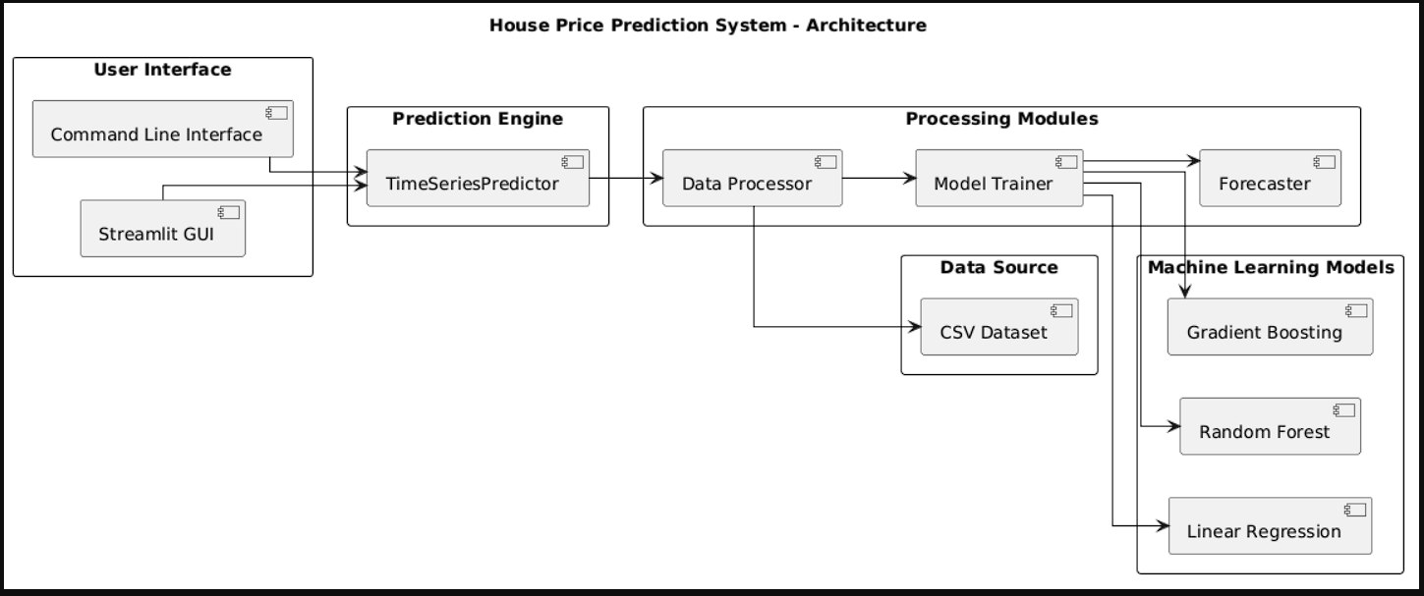
IV Year – II Sem| Project Development Phase – II | Project Review
System Architecture
School of Emerging Technologies: CSE (DS), CSE(IoT) & CSE(CyS) | MRCET (A) Campus

Slide 7
IV Year – II Sem| Project Development Phase – II | Project Review
Technical Requirements Specification (TRS)
School of Emerging Technologies: CSE (DS), CSE(IoT) & CSE(CyS) | MRCET (A) Campus

Slide 8
IV Year – II Sem| Project Development Phase – II | Project Review
Software Requirements Specification(SRS)
Operating System: Windows 10/11 (64-bit)
Programming Language: Python 3.8
IDE: Visual Studio Code
Web Framework: streamlit GUI
Machine Learning Libraries: Sklearn, Pandas, Numpy
School of Emerging Technologies: CSE (DS), CSE(IoT) & CSE(CyS) | MRCET (A) Campus

Slide 9
IV Year – II Sem| Project Development Phase – II | Project Review
Hardware Requirements Specification(HRS)
Processor: Intel Core i5
RAM: 8 GB
Hard Drive: 1 TB SSD
Graphics Card: Dedicated GPU with 4 GB VRAM
School of Emerging Technologies: CSE (DS), CSE(IoT) & CSE(CyS) | MRCET (A) Campus

Slide 10
IV Year – II Sem| Project Development Phase – II | Project Review
Application Modules
Module - 1 : Data Collection
Module - 2 : Data Cleaning & Transformation
Module - 3 : Data Modeling
Module - 4 : Machine learning and Model training Module - 5 : Visualization & Dashboard Module
School of Emerging Technologies: CSE (DS), CSE(IoT) & CSE(CyS) | MRCET (A) Campus

Slide 11
IV Year – II Sem| Project Development Phase – II | Project Review
System Models
(UML Diagrams)
School of Emerging Technologies: CSE (DS), CSE(IoT) & CSE(CyS) | MRCET (A) Campus

Slide 12
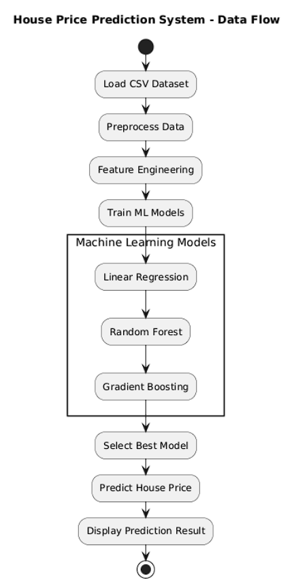
IV Year – II Sem| Project Development Phase – II | Project Review
Dataflow Diagram
School of Emerging Technologies: CSE (DS), CSE(IoT) & CSE(CyS) | MRCET (A) Campus

Slide 13
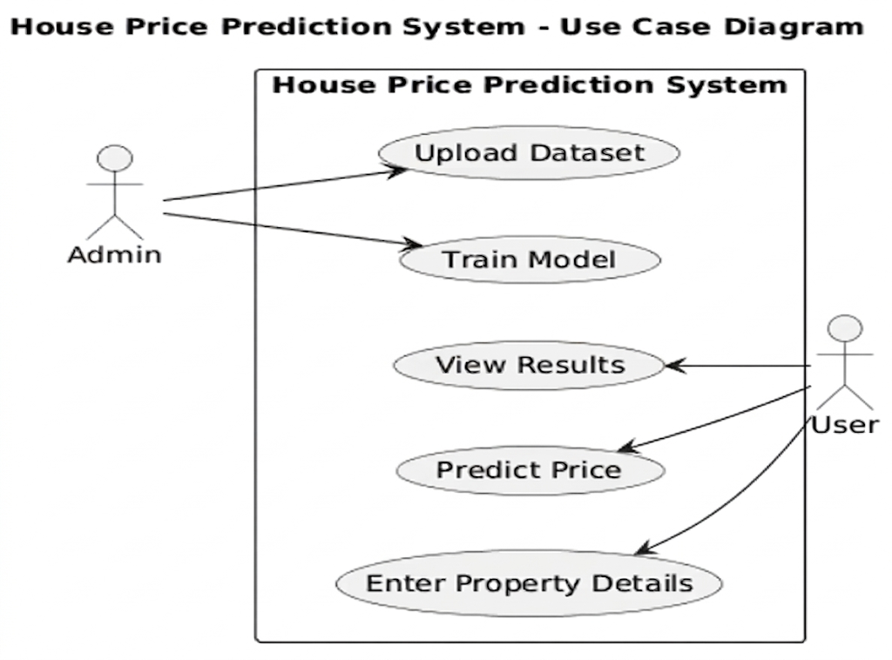
IV Year – II Sem| Project Development Phase – II | Project Review
Use Case Diagram
School of Emerging Technologies: CSE (DS), CSE(IoT) & CSE(CyS) | MRCET (A) Campus

Slide 14
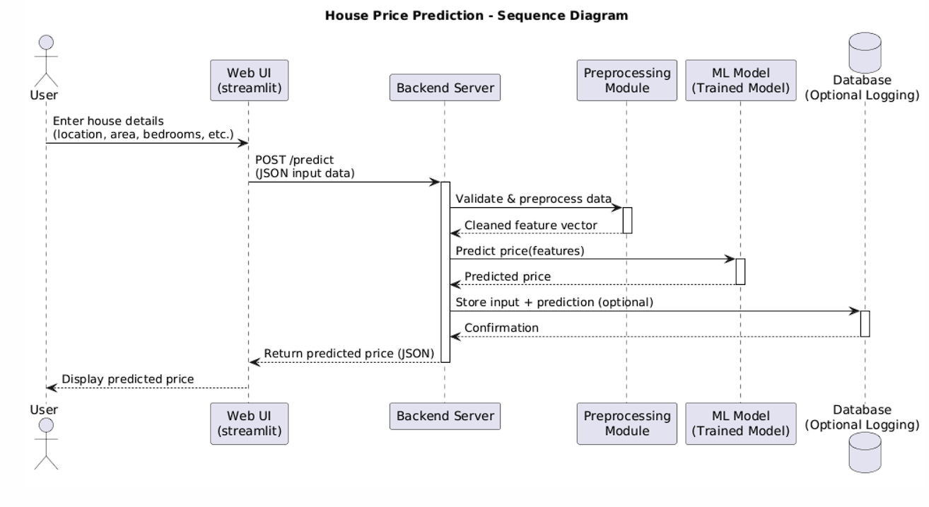
IV Year – II Sem| Project Development Phase – II | Project Review
Sequential Diagram
School of Emerging Technologies: CSE (DS), CSE(IoT) & CSE(CyS) | MRCET (A) Campus

Slide 15
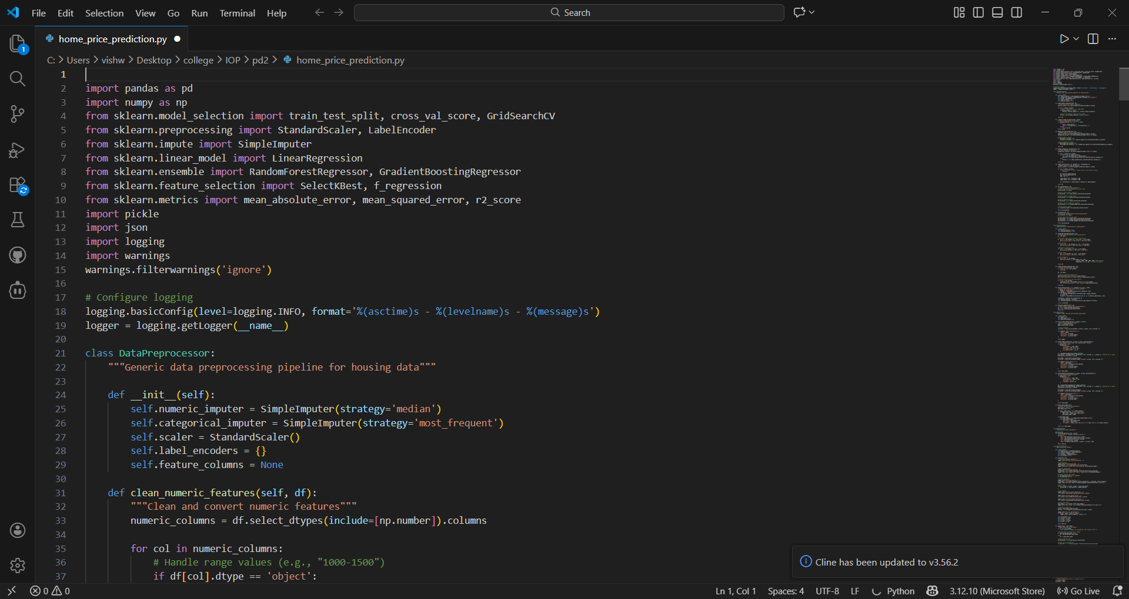
IV Year – II Sem| Project Development Phase – II | Project Review
Implementation
School of Emerging Technologies: CSE (DS), CSE(IoT) & CSE(CyS) | MRCET (A) Campus

Slide 16
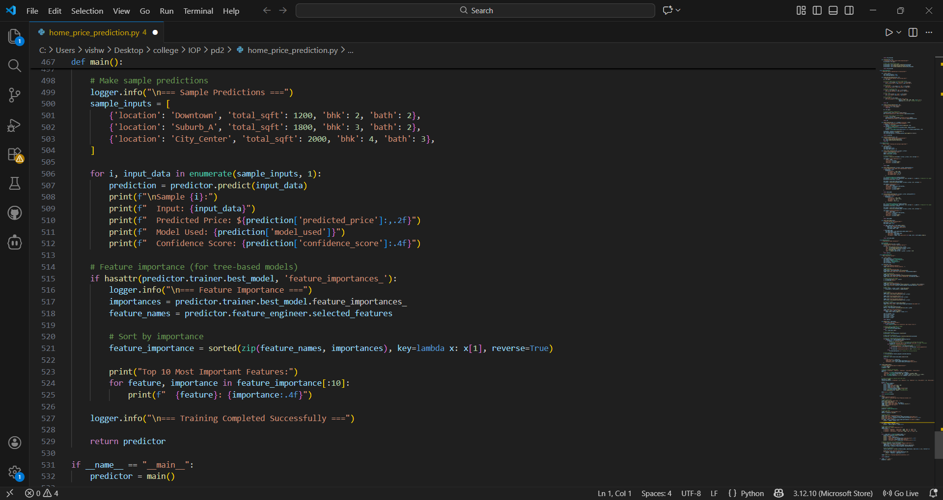
IV Year – II Sem| Project Development Phase – II | Project Review
Implementation
School of Emerging Technologies: CSE (DS), CSE(IoT) & CSE(CyS) | MRCET (A) Campus

Slide 17
IV Year – II Sem| Project Development Phase – II | Project Review
Output Screens
School of Emerging Technologies: CSE (DS), CSE(IoT) & CSE(CyS) | MRCET (A) Campus

Slide 18
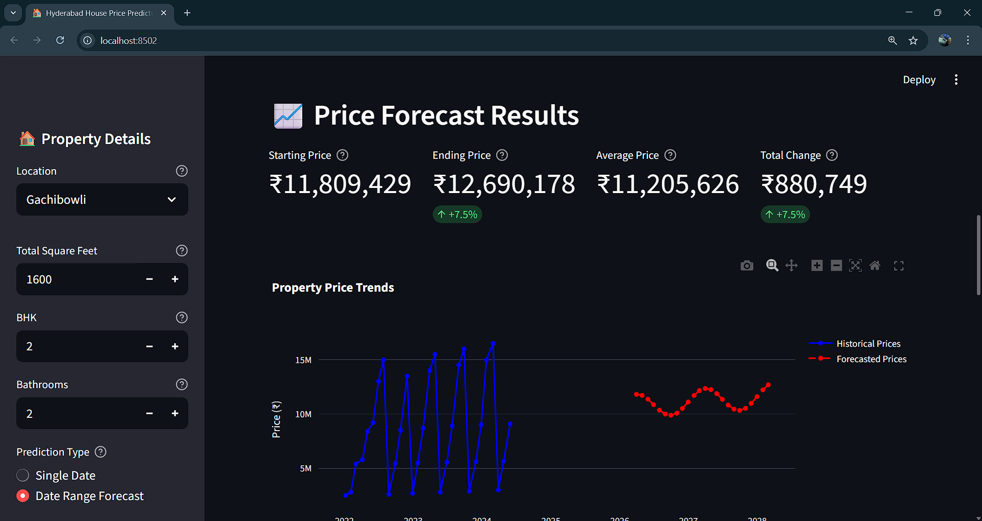

Slide 19
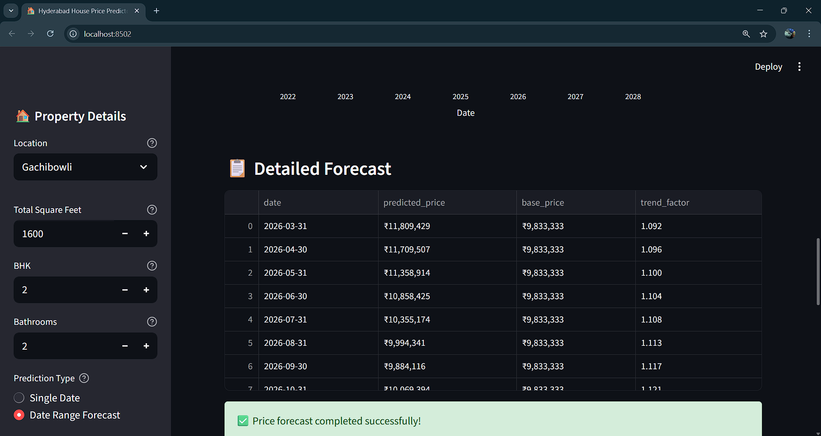

Slide 20
IV Year – II Sem| Project Development Phase – II | Project Review
Conclusion & Future Scope
School of Emerging Technologies: CSE (DS), CSE(IoT) & CSE(CyS) | MRCET (A) Campus

Slide 21
IV Year – II Sem| Project Development Phase – II | Project Review
Conclusion
Accurate Forecasting: Built on real-world datasets from cities and towns, the project predicts housing prices using advanced data science models
Decision Support: Provides valuable insights for real estate investments and asset management.
Financial Planning: Helps individuals anticipate rental cost trends and manage savings effectively.
School of Emerging Technologies: CSE (DS), CSE(IoT) & CSE(CyS) | MRCET (A) Campus

Slide 22
IV Year – II Sem| Project Development Phase – II | Project Review
Future Scope
Enhanced Data Integration: Future expansion can include features such as air quality index (AQI), groundwater levels, community networks, and public facilities.
Urban Development Insights: Predictive modeling can identify suitable locations for high-rise construction based on ground type and environmental factors.
School of Emerging Technologies: CSE (DS), CSE(IoT) & CSE(CyS) | MRCET (A) Campus

Slide 23
IV Year – II Sem| Project Development Phase – II | Project Review
Future Scope
Government Planning Support: Provides guidance on acquiring affordable land for infrastructure projects and developing new urban areas.
School of Emerging Technologies: CSE (DS), CSE(IoT) & CSE(CyS) | MRCET (A) Campus

Slide 24
IV Year – II Sem| Project Development Phase – II | Project Review
Thank You
School of Emerging Technologies: CSE (DS), CSE(IoT) & CSE(CyS) | MRCET (A) Campus

